Slide 1
Chapter 1 - Databases

Slide 2
Content
Introduction
Characteristics of Database Approach
Files vs. Databases
Advantages Of Using DBMS
When Not To Use DBMS

Slide 3






Introduction
Databases and database systems are an essential component of life in modern society.
Traditional database applications: Most of the information that is stored and accessed is either textual or numeric. Examples are:
Big data or No SQL Systems: Social media websites, such as Facebook, Twitter, instagram among many others
has required the creation of huge databases that store nontraditional data, such as posts, tweets, images, and video clips.
New types of database systems, often referred to as big data storage systems, or NOSQL systems, have been created to manage data for social media applications.
Deposit or withdraw
funds
Making a hotel or airline reservation
Access a computerized library catalog
Purchase something online

Slide 4
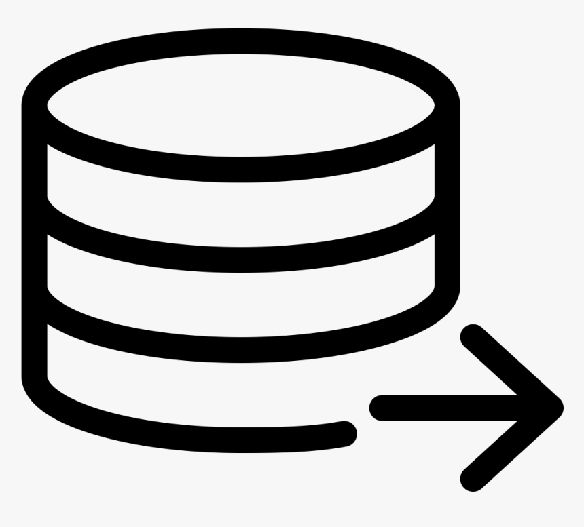


Introduction
Database – unified collection of related data.
Data means known facts that can be recorded and that have some meaning.
For example, mobile phones have their own simple database software and typically store Names, Telephone numbers and Addresses of the people etc.
A database has:
Changes are needed in DBMS because of any action performed by user or (for example, a customer buys a camera) or some events might occur (for example, an employee’s postal address is changed).
To maintain accuracy and reliability, its much needed to update changes in database as soon as possible.
A database can be of any size and complexity.
For example, the list of names and addresses may consist of only a few hundred records.
A database of even greater size and complexity would be maintained by a social media company such as Facebook, which has more than a billion users.
Example of a large commercial database is Amazon.com
Some source from which data is derived
Degree of interaction with events in the real world
An audience interested in its contents

Slide 5
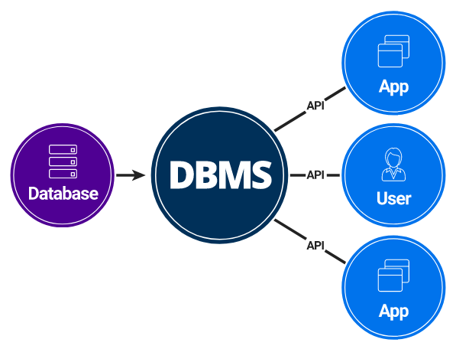
Introduction
A database may be generated or maintained manually or computerized.
A computerized database is managed by group of application programs that are written to perform a task.
A database management system (DBMS) is a computerized system that enables users to create and maintain a database.

Slide 6
Introduction
DBMS - General-purpose software system that facilitates the processes of:
1
Defining
Defining a database involves specifying:
Data types,
Structures,
Constraints of the data.
Meta-data - The database definition stored by the DBMS in the form of a database catalog or dictionary.
Stored in: specialist document/metadata repository
3
Manipulating
Includes functions such as querying the database to:
retrieve specific data,
updating the database
and generating reports.
2
Constructing
Process of storing the data on some storage medium that is controlled by the DBMS.
4
Sharing
Allows multiple users and programs to access the database simultaneously.
An application program accesses the database by sending queries or requests for data to the DBMS.
A query causes some data to be retrieved.
A transaction may cause some data to be read and some data to be written into the database.

Slide 7
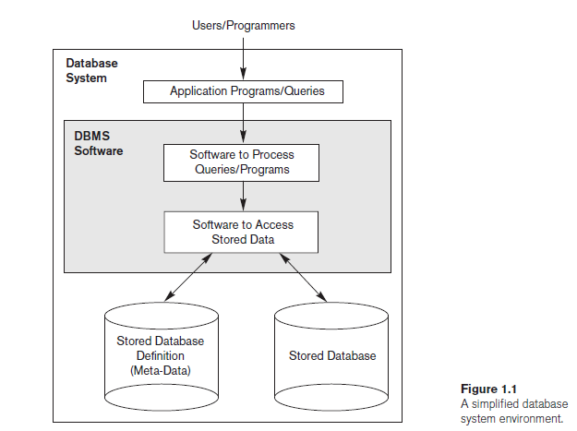
Introduction
DBMS provides data protection & maintenance over a longer period of time.
Protection
system protection against hardware or software malfunction (or crashes)
security protection against unauthorized or malicious access.
Maintenance
A typical large database may have a life cycle of many years, so the DBMS must be able to maintain the database system by allowing the system to evolve as requirements change over time.
We can call database and database software together as a database system

Slide 8
Data Storage
How data is stored?
file processing systems
Stored using some spreadsheets or notepad files etc.
Problems:
Have data redundancy issue
Redundant efforts needed
Storage wastage
Inconsistent data formats
Databases
Store data in properly built and normalized data units
Centralized repository for entertaining multiple users at a time
Avoid data redundancy
Which approach is better and why?

Slide 9

file system Approach
Traditional file processing - each user defines and implements the files needed for a specific software application as part of application programming.
Similar information of student is stored in two separate files ~ data redundancy
USER 1
Grade reporting office
Keep files of students and their grades
USER 2
Accounting office
Keep track of students’ fees and their payments

Slide 10
Characteristics of Database Approach
Database System - a single repository maintains data that is defined once and then accessed by various users repeatedly through queries, transactions, and application programs.
The main characteristics of the database approach versus the file-processing approach are the following:
Self-describing nature of a database system
Insulation between programs and data, and data abstraction
Support of multiple views of the data
Sharing of data and multiuser transaction processing

Slide 11
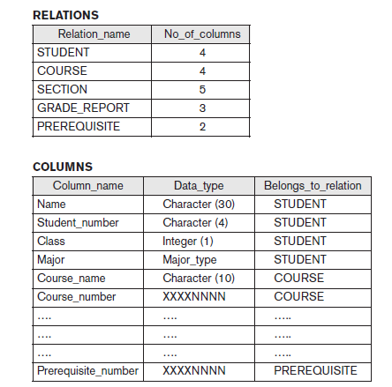
Characteristics of Database Approach
Self-Describing Nature of a Database System
A database system contains database as well as the complete definition of the database structure and constraints.
This definition is stored in the DBMS catalog contains information such as:
the structure of each file,
the data type and storage format of each data item,
and various constraints on the data.
This information is termed as meta-data.
NoSQL databases do not contain metadata because data is stored in self describing manner as item name and value stored together.
Whenever a request is made to access, say, the Name of a STUDENT record, the DBMS software refers to
the catalog to determine the structure of the STUDENT file
and the position and size of the Name data item within a STUDENT record.
In file system, you have to give the location or information related to file and in db. it isn’t required.
Database catalog in a database

Slide 12
Characteristics of Database Approach
Insulation between programs and data, and data abstraction
Traditional File Processing | DBMS
The structure of data files is embedded in the application programs, so any changes to the structure of a file may require changing all programs that access that file. | DBMS access programs do not require such changes in most cases. The structure of data files is stored in the DBMS catalog separately from the access programs known as program-data independence.

Slide 13
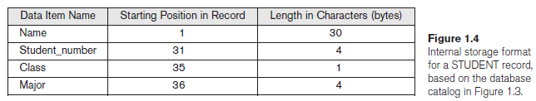
Characteristics of Database Approach
Insulation between programs and data, and data abstraction
For example, a file access program may be written in such a way that it can access only STUDENT records of the structure shown.
If we want to add another piece of data to each STUDENT record, say the Birth_date, such a program will no longer work and must be changed.
In a DBMS environment, we only need to change the description of STUDENT records in the catalog to show the new data item Birth_date; no programs are changed.

Slide 14
Characteristics of Database Approach
Insulation between programs and data, and data abstraction
In some types of database systems, such as object-oriented and object-relational systems users can define operations on data as part of the database definitions.
Operation (also called a function or method) is specified in two parts.
The interface (or signature) - includes the operation name and the data types of its arguments (or parameters).
The implementation (or method) - is specified separately and can be changed without affecting the interface.
User application programs can operate on the data by invoking these operations through their names and arguments called as program-operation independence.
For example, an operation CALCULATE_GPA can be applied to a STUDENT object to calculate the grade point average.
Data abstraction - The characteristic that allows program-data independence and program-operation.
A DBMS provides users with a conceptual representation of data that does not include many of the details of how the data is stored or how the operations are implemented.

Slide 15
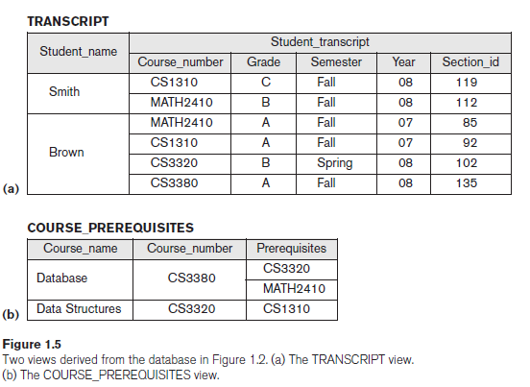
Characteristics of Database Approach
Support of Multiple Views of the Data
View - a subset of the database or it may contain virtual data that is derived from the database files but is not explicitly stored.
A multiuser DBMS whose users have a variety of distinct applications must provide facilities for defining multiple views.
For example:
One user of the database may be interested only in accessing and printing the transcript of each student; the view for this user is shown in Figure 1.5(a).
A second user, who is interested only in checking that students have taken all the prerequisites of each course for which the student registers, may require the view shown in Figure 1.5(b).

Slide 16
Characteristics of Database Approach
Sharing of Data and Multiuser Transaction Processing
DBMS must allow multiple users to access the database at the same time.
DBMS should have a concurrency control system that ensures one transaction performance at a time. And avoid writing or reading conflicts.
Transaction - A transaction is a unit of program execution that accesses and possibly updates various data items.
ACID properties of transaction processing are:
Atomicity . Either all operations of the transaction are properly reflected in the database or none are.
Consistency . Execution of a transaction in isolation preserves the consistency of the database.
Isolation: effect of a transaction is independent of other transactions in a system
Durability: changes made by a transaction should not be lost by any failure

Slide 17
Files vs. Databases
File Systems | Databases
File System is a software that manages & organizes files on a storage medium in your PC | DBMS is a software for managing databases
Data redundancy | No data redundancy issue
No backup/recovery methods for data if its lost | Data backup & recovery system is available
No efficient query processing system as you get the whole file in return of a keyword search | Efficient query processing system
Inconsistent data may exist because of data redundancy issue | Data consistency ensured with normalization
Less security | More secure (views, stored procedures etc.)
Less expensive | DBMS creation and management needs a lot of efforts and time. So its costly.

Slide 18
Advantages Of Using DBMS
Controlling Redundancy
In file processing Systems, every user group maintains its own files for handling its data-processing applications.
For example: UNIVERSITY database
Two groups of users: 1. Course registration personnel 2. Accounting office.
In the traditional approach, each group independently keeps files on students.
1.The accounting office keeps data on registration and related billing information
2. The registration office keeps track of student courses and grades.

Slide 19
Advantages Of Using DBMS
Controlling Redundancy
This redundancy in storing the same data multiple times leads to several problems.
This data redundancy can be controlled in databases using normalization.
1. Need to perform a single logical update such as entering data on a new student multiple times, once for each file where student data is recorded. This leads to duplication of effort.
2. Storage space is wasted when the same data is stored repeatedly.
3. Files that represent the same data may become inconsistent. This may happen because an update is applied to some of the files but not to others.
Even if an update—such as adding a new student—is applied to all the appropriate files, the data concerning the student may still be inconsistent because the updates are applied independently by each user group.
For example, one user group may enter a student’s birth date erroneously as ‘JAN-19-1988’, whereas the other user groups may enter the correct value of ‘JAN-29-1988’.

Slide 20
Advantages Of Using DBMS
Restricting Unauthorized Access
When multiple users share a large database, most users will not be authorized to access all information in the database.
Users’ access and data management should be controlled and security policies are enforced by DBA.
For example, financial data such as salaries and bonuses is often considered confidential, and only authorized persons are allowed to access such data.
A DBMS should provide a security and authorization subsystem
the DBA uses to create accounts and specify account restrictions.
For example, only the DBA’s staff may be allowed to use certain privileged software, such as the software for creating new accounts.

Slide 21
Advantages Of Using DBMS
Providing Persistent Storage for Program Objects
Databases can be used to provide persistent storage for program objects and data structures.
Programming languages typically have complex data structures, such as structs or class definitions in C++ or Java. The values of program variables or objects are discarded once a program terminates, unless stored in permanent files. storing the items require saving structures in to suitable file formats.
A complex object in C++ can be stored permanently in an object-oriented DBMS. Such an object is said to be persistent, since it survives the termination of program execution. Object oriented DBMS allows you to use the persistent objects later on.
OODBMS offers data structure compatibility with one or more OOP languages

Slide 22
Advantages Of Using DBMS
Providing Storage Structures and Search Techniques for Efficient Query Processing
The DBMS must provide specialized data structures and search techniques to speed up disk search for the desired records.
Indexes are often used for this purpose.
Indexes are typically based on tree data structures or hash data structures that are highly effective for disk search.
Choosing which index to speedup searching is done by DBA
An efficient query execution plan for each query based on the existing storage structures is selected by DBMS.
Done by query processing & optimization module in DBMS.
We will discuss that in later chapters

Slide 23
Advantages Of Using DBMS
Providing Backup and Recovery
The backup and recovery subsystem of the DBMS is responsible for recovery.
For example, if the computer system fails in the middle of a complex update transaction, the recovery subsystem is responsible for making sure that the database is restored to the state it was in before the transaction started executing.
Creating save points, checkpoints and transaction rollback in case of any failure
We will cover that in detail while studying transaction processing systems

Slide 24
Advantages Of Using DBMS
Providing Multiple User Interfaces
Many types of users with different levels of technical knowledge use a database, so a DBMS should provide a variety of user interfaces that include:
apps for mobile users,
query languages for casual users,
programming language interfaces for application programmers,
Forms/menu-driven interfaces also called GUI for standalone users.

Slide 25
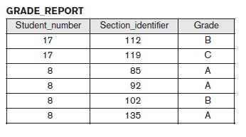
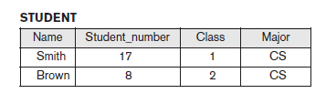
Advantages Of Using DBMS
Representing Complex Relationships among Data
A DBMS must handle many varieties of data that are interrelated in many ways.
The record for ‘Brown’ in the STUDENT file is related to four records in the GRADE_REPORT file.

Slide 26
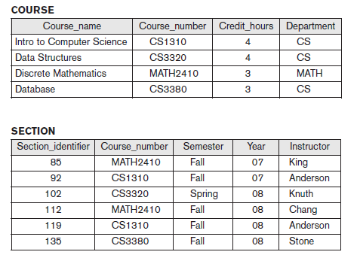
Advantages Of Using DBMS
Enforcing Integrity Constraints
Most database applications have integrity constraints that must hold.
The simplest type of integrity constraint involves specifying a data type for each data item.
For example, we specified that the value of the Class data item within each STUDENT record must be a one-digit integer and that the value of Name must be a string of no more than 30 alphabetic characters.
A more complex type of constraint that involves specifying that a record in one file must be related to records in other files known as a referential integrity constraint.
For example, in Figure 1.2, we can specify that every section record must be related to a course record.
Another type of constraint specifies uniqueness on data item values, such as every course record must have a unique value for Course_number. This is known as a key or uniqueness constraint.

Slide 27
Advantages Of Using DBMS
Permitting Inferencing and Actions Using Rules and Triggers
Deductive database systems deduce new information from the stored database facts Because it contains the deduction rules for inferring from the data.
For example, there may be complex rules for determining when an employee is on probation. These can be specified as rules, which when compiled and maintained by the DBMS can determine all employees on probation.
A trigger is a form of a rule activated by updates to the table, which results in performing some additional operations to some other tables, sending messages, and so on.
More involved procedures to enforce rules are popularly called stored procedures, they become a part of the overall database definition and are invoked when certain conditions are met.

Slide 28
When Not to Use a DBMS
There are a few situations in which a DBMS may involve unnecessary overhead costs that would not be incurred in traditional file processing. The overhead costs of using a DBMS are due to the following:
High initial investment in hardware, software, and training
DBMS needs a high-speed processor and also a large memory size leads to costly hardware resources and Educated staff (database administrator, application programmers, data entry operations).
The generality that a DBMS provides for defining and processing data
Overhead for providing security, concurrency control, recovery, and integrity functions
Therefore, it may be more desirable to develop customized database applications under the following circumstances:
Realtime requirements for some application programs that may not be met because of DBMS overhead
Embedded systems with limited storage capacity, where a general-purpose DBMS would not fit
No multiple-user access to data
Certain industries and applications have elected not to use general-purpose DBMSs.
For example, many computer-aided design (CAD) tools used by mechanical and civil engineers have proprietary file and data management software that is geared for the internal manipulations of drawings and 3D objects.

